Slide 1
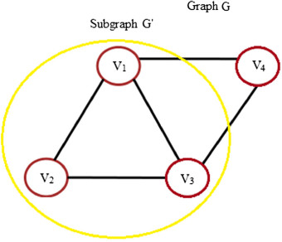

Subgraphs
A subgraph G’ of graph G i.e., ($G′⊂G$) is a graph, each of whose vertices ($V′⊂V$) and edges ($E′⊂E$)
Transitivity rule:
if $G′′⊂G′⊂G$, then $G′′⊂G$

Slide 2
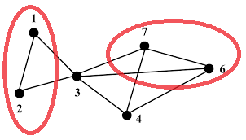
Edge-disjoint Subgraphs
Subgraphs G’ and G’’ of graph G are edge disjoint if G’ and G’’ do not have any edge in common

Slide 3
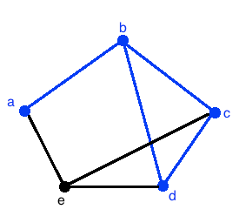
Walk (repeating edges or vertices is fine)
A walk in a graph G = (V, E) is a finite sequence of vertices and edges that begins from any vertex V₀ and ends at any vertex V_{k}
E.g., abcdbcd is a walk
Open Walk: A walk that has different starting and ending vertices i.e., V₀ ≠ V_{k}
E.g., abc is an open walk
Closed Walk: A walk that has the same starting vertex as its ending vertex i.e., V₀ = V_{k}
E.g., abcdba is a closed walk

Slide 4
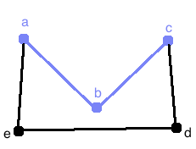
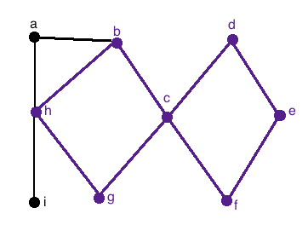
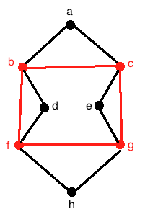
Trails, Circuits, Cycles
Trails are walks with no edge repeated
E.g., abc is a trail
Circuit is a closed trail having same starting and ending vertex, while in between vertices may repeat as well
E.g., hbcdefcgh
Cycles are circuits with only one repeated vertex i.e., the starting vertex as its ending vertex
E.g., bcgfb

Slide 5
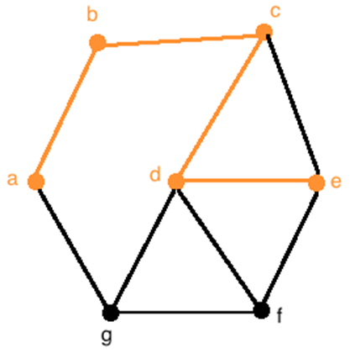
Paths
A Path is a trial with no repeated vertex (so it has to be an open trail)
E.g., abcde is a path

Slide 6

Connected / Disconnected Graph
A graph G is connected if there is at least one path between each pair of vertices in G. Otherwise its disconnected
Each connected part in a disconnected graph is called a component or a community
A simple graph with N vertices and K components can have at most $\frac{(N−K)(N−K+1)}{2}$ edges

Slide 7
Adjacency, Incidences and Degree
Adjacency:
Two vertices V₁ and V₂ are adjacent if there is an edge joining them
A vertex to vertex property
Incidence:
If V₁ and V₂ are joined by an edge e, then both V₁ and V₂ are incident on edge e
An edge to edge or edge to vertex property
Degree:
Degree of a vertex V in graph G is the number of edges incident with V and is written as deg(V) or d(V)
A vertex property

Slide 8
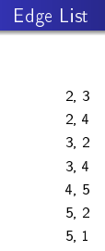
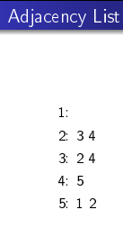
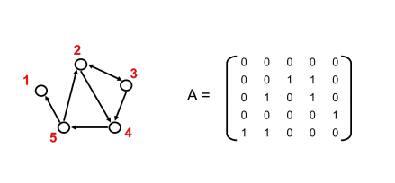
Adjacency Matrix, Edge List & Adjacency list
Adjacency matrix

